Slide 1
Space Station Activities
By Matthew Katterman

Slide 2
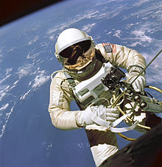
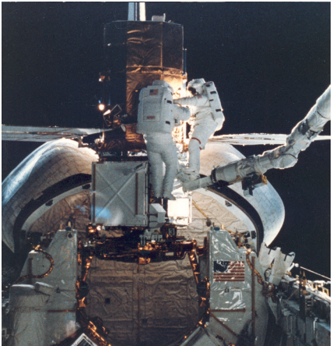
Extravehicular Activities
EVA – Any activity done by an astronaut outside of a spacecraft. Requires a space suit
Space stations require assembly, repair and maintenance.
Replacement or repair of equipment.
Astronauts must capture and repair other space structures – satellites and telescopes

Slide 3
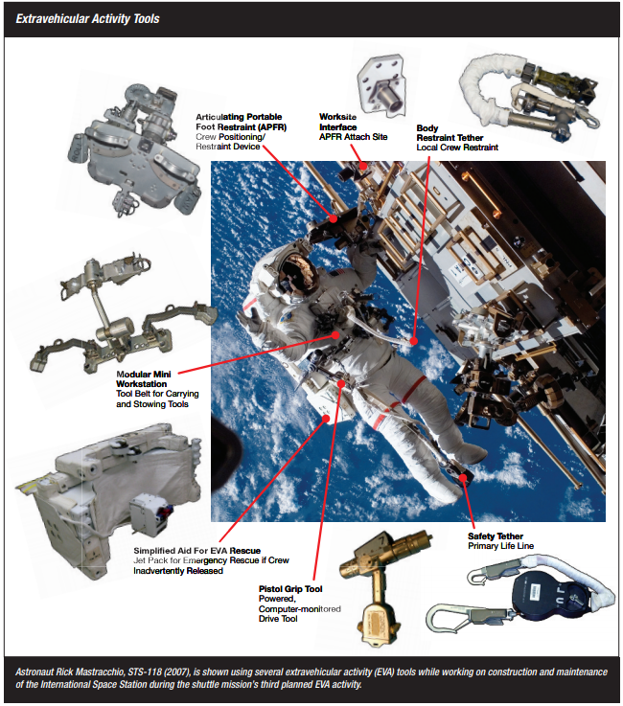
EVA Tools and Equipment
Tethers – Body Restraint and Safety Tether
Foot Restraint
Pistol Grip Tool
Mini Workstation

Slide 4
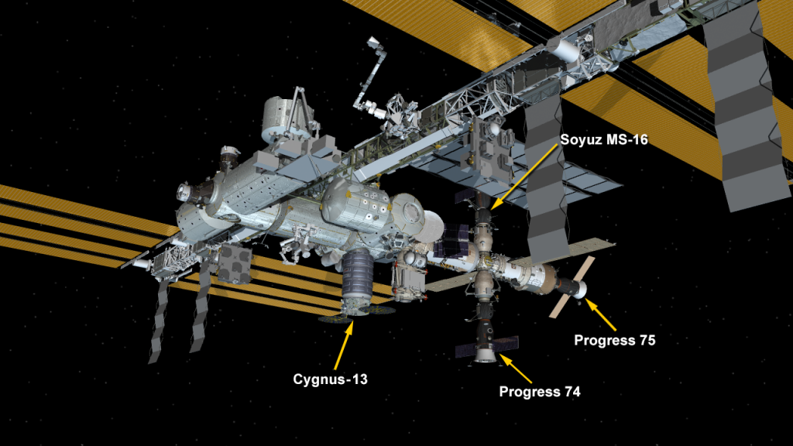
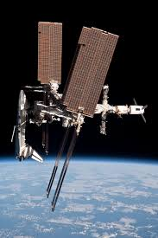
Docking at a Space Station
Cargo Spacecraft
Space shuttle

Slide 5
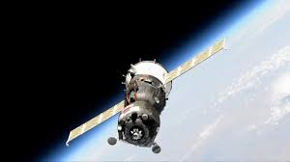
Vehicle Docking Activity
Dock at several Space Stations with a spacecraft.
Travel within a coordinate plane
Quadrant 1
Y
Quadrant 2
Y-Axis
Alexa
2
Galileo
Vectors
X
1
Giligan
X
X-Axis
3
Libre
Quadrant 4
Quadrant 3
Y

Slide 6
Vehicle Docking Activity
Have thrusters that can only travel in x or y directions.
Thrusters must alternate between 3 and 1 unit moves.
Fast Moving Particles
Y
Q 2
Q 1
Alexa
Thermal Radiation
Galileo
X
Giligan
X
Q 4
Q 3
Solar Radiation
Liger
Equipment Distortion
Y

Slide 7
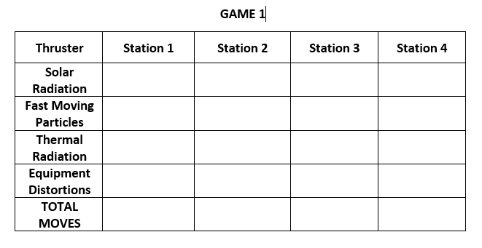
Filling out movement chart (Blank Chart to begin with)

Slide 8
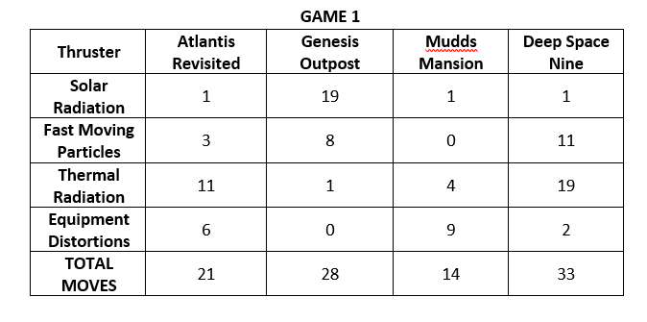
Filling out movement chart (After the game is over)

Slide 9
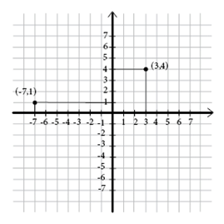
Ordered pairs
(-5, 6)
Count X distance first
Count Y distance second
Left and down are negative
Right and up are positive
Ordered pair = Point
(X distance, Y distance)
(5, -5)
(-3, -8)
Mathplanet.com

Slide 10
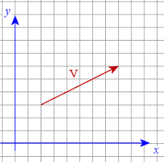
Vectors
Line with an arrow between 2 points
Has direction and magnitude
Defined by two coordinate points
A & B, AB
Represented by a coordinate pair also
(x distance, y distance)
(6, 3)
AB
B
y = ?
A
x = ?

Slide 11
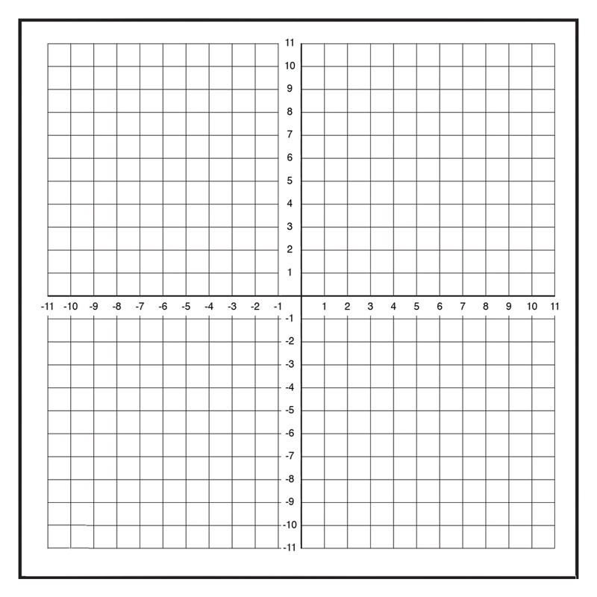
More on vectors
To find vector AB or BC, calculate x & y distances from coordinate points
What is (x₁,y₁) A?
What is (x₂,y₂) B?
What is (x₃,y₃) C?
AB = (x₂ – x₁, y₂ – y₁)
AB = (6 – (-5), 7 – 3)
BC = (x₃ – x₂, y₃ – y₂)
BC = (3 – 6, -6 – (7))
(6, 7)
(x₂ , y₂ )
x₂ – x₁ = ?
B
(11, 4)
y₂ – y₁ = ?
(-5, 3)
A
(x₁ , y₁ )
y₃ – y₂ = ?
x₃ – x₂ = ?
(x₃ , y₃ )
C
(-3, -13)
(3, -6)

